Slide 1

File based Interfaces

Slide 2
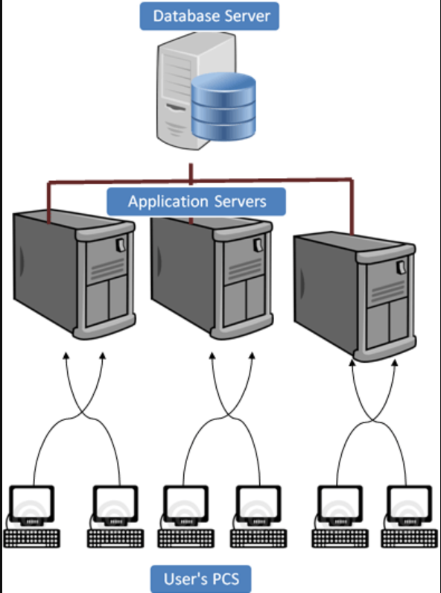
3 Tier Architecture
Presentation Server - (server which directly handle the sap user(GUI).)
Application Server – it provides interfacing b/w the database & presentation server.
Database Server - main server which have all the data information and tables

Slide 3
Inbound vs Outbound Interfaces
data coming from legacy system or other sap/non sap system into the sap system. if the data is coming in to the SAP System that is called as an inbound interface
data is going out from SAP system to the legacy system it is called an outbound interface .

Slide 4
Types of Interfaces
File interfaces are used when data is transferred from non-sap system into sap-system required format.
EDI interfaces are used when data is transferred from legacy system in non-readable format(for SAP) & which is converted to EDI format by middleware & then brought into SAP.
ALE is used when data is transferred between 2 SAP systems. The vehicle for data transfer is called an IDoc.

Slide 5
What is AL11 and what is it’s use?
AL11 is used for storing files/data on application server so that anyone (SAP) and even third-party systems (Non-SAP) can pick files from it. It is SAP File Directory as it contains directories, multiple folders and files in them. We can upload/download/modify/delete files/folders in t-code AL11.

Slide 6
Upload/download from AL11
1. Upload File to AL11:
T.code : CG3Z this is used to Upload the file from the Presentation server
Source file on front end
Target file on application server
Using Code:
OPEN DATASET
"Open the file to write.
OPEN DATASET lv_filepath FOR OUTPUT IN TEXT MODE ENCODING DEFAULT.

Slide 7
Upload to AL11
T.code : CG3Z this is used to Upload the file from the Presentation server
Source file on front end
Target file on application server
Using Code:
OPEN DATASET
"Open the file to write.
OPEN DATASET lv_filepath FOR OUTPUT IN TEXT MODE ENCODING DEFAULT.
TRANSFER
CLOSE DATASET

Slide 8
download from AL11
1. TCODE CG3Y:
This is used to Download the file from the application server Source file on application server and Target file on front end
2. Using Code
OPEN DATASET
"Open the file to write.
OPEN DATASET lv_filepath FOR OUTPUT IN TEXT MODE ENCODING DEFAULT.
TRANSFER
CLOSE DATASET

Slide 9
download from AL11
OPEN DATASET dset FOR access IN mode [position] [os_additions] [error_handling].
Input: It opens the file for reading. If the file does not exist, the sy-subrc is set to 8.
Output: Opens the file for writing. If the file exists, the content will be deleted and replaced. If the file does not exist, the file will be created.
Appending: It opens the file for appending. The new content will be added to the end of existing file or the file will be created if it does not exist. SY-SUBRC = 4 will be triggered if appending is not successful.
Update: It opens the file for changes to the existing content.
Mode: You can specify which mode you want to read the file like binary or text.

